Slide 1
Project

Slide 2
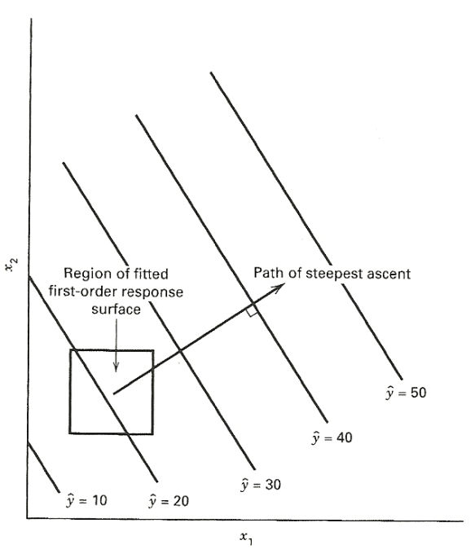
Steepest Ascent
We perform this to try to reach the optimum in fastest possible way
To perform it in fastest way, we perform experiment in the steepest ascent (or descent) until we are sure that we reached an optimum
The fastest direction is normal to the fitted response surface
The steps along the path are proportional to regression coefficients
Notes:
SA1: https://www.intechopen.com/source/html/45303/media/image25.png

Slide 3
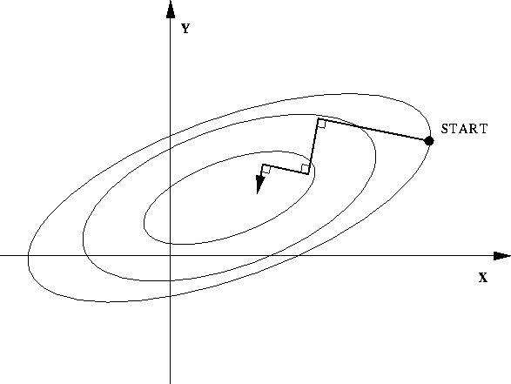
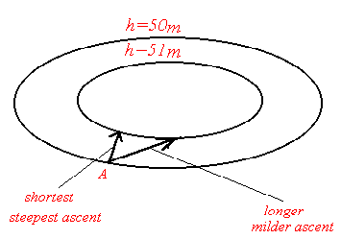
Notes:
SA2: http://www.interpore.org/ref-mat_pub/mgfc-course/steepest.gif
SA3: http://trond.hjorteland.com/thesis/img200.gif

Slide 4
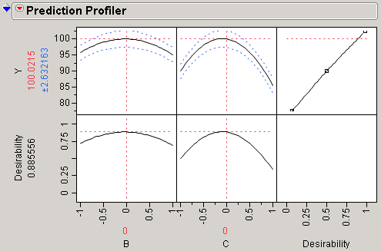
Central Composite Design
Once no factors remain significant, we check if solution is optimum
CCD does so by analyzing second order response surface
Rotatable CCD to capture more variance
If you do not observe concave down curves for some factor, perform steepest ascent on it again

Slide 5
Fractional factorial design: 32 + 4 center points
Stepwise regression for screening
Find new x0
Build model to check for significant factors remaining
Continue steepest ascent on remaining factors
Perform CCD using the significant factors you found in step 1
Steepest Ascent

Slide 6
Keep in mind…
If while performing CCD, values out of range, reduce lambda. You can go as low as 0.01.
If for performing CCD, you do not have enough runs left, use top most significant factors to perform CCD.
While performing “make model” followed by “steepest ascent”, if you have lot of interaction terms, instead of least squares regression, perform stepwise regression.
Keep saving your data tables. You don’t want to perform runs again just because you end up losing your data tables!

